Slide 1
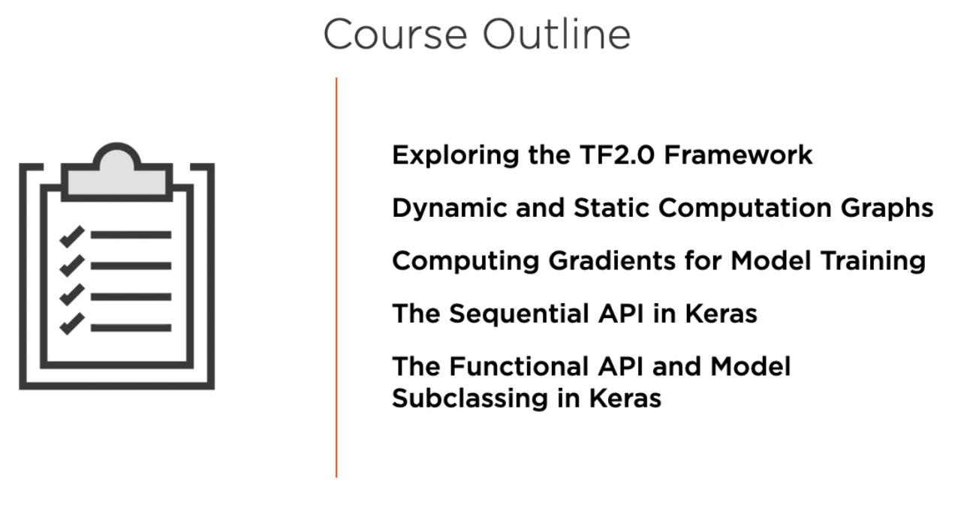

Slide 2
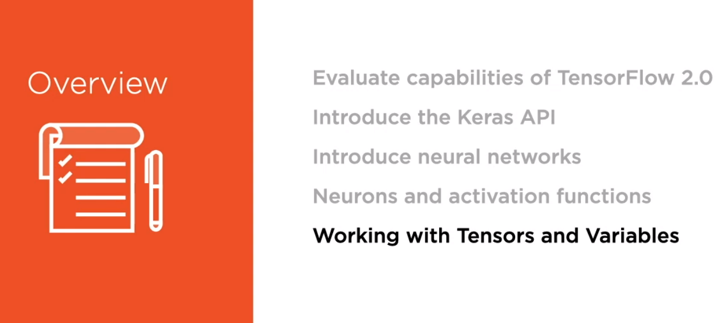
Module 1: Exploring the TensorFlow 2.0 Framework

Slide 3
Contents in Brief in Module 1
A. TensorFlow 1.x vs TensorFlow 2.0
B. Introducing Neural Networks
C. Neurons and Activation Functions
D. Working with Tensors and Variables

Slide 4

A. TensorFlow 1.x vs TensorFlow 2.0

Slide 5
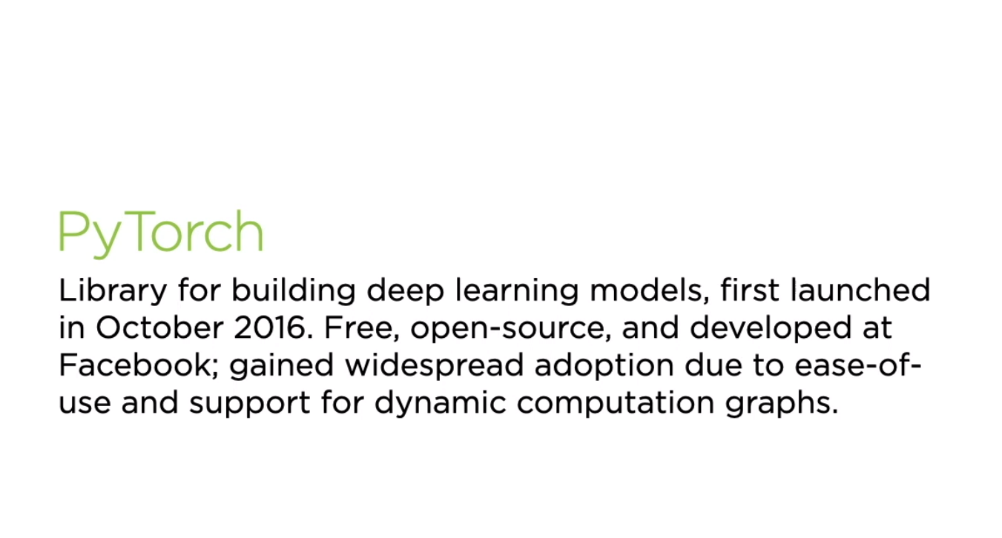
A. TensorFlow 1.x vs TensorFlow 2.0

Slide 6
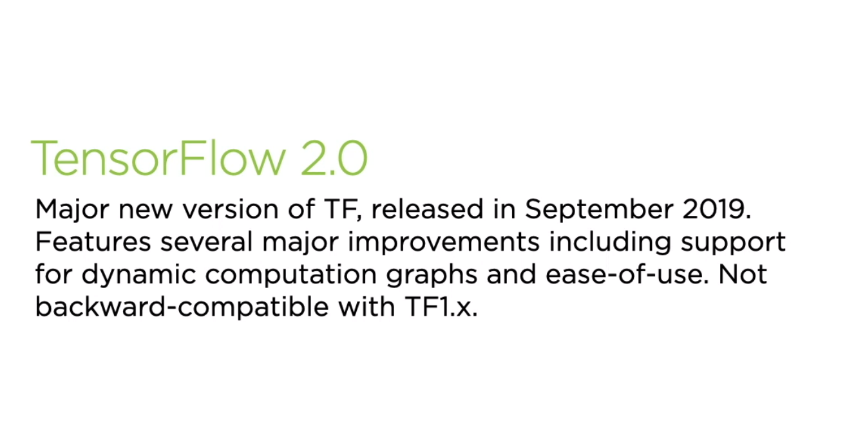
A. TensorFlow 1.x vs TensorFlow 2.0

Slide 7
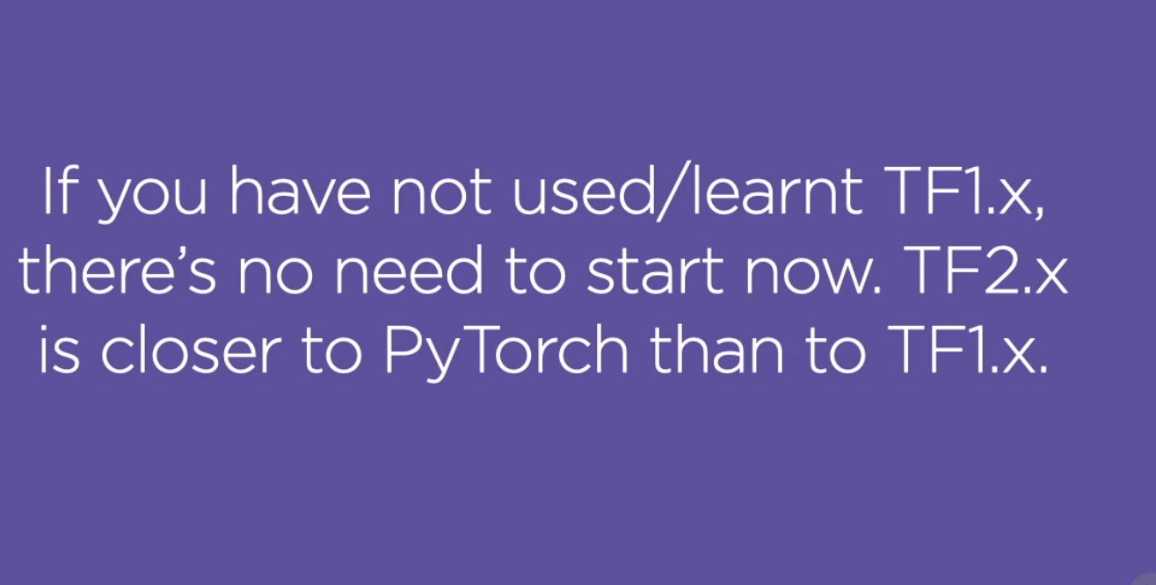
A. TensorFlow 1.x vs TensorFlow 2.0

Slide 8
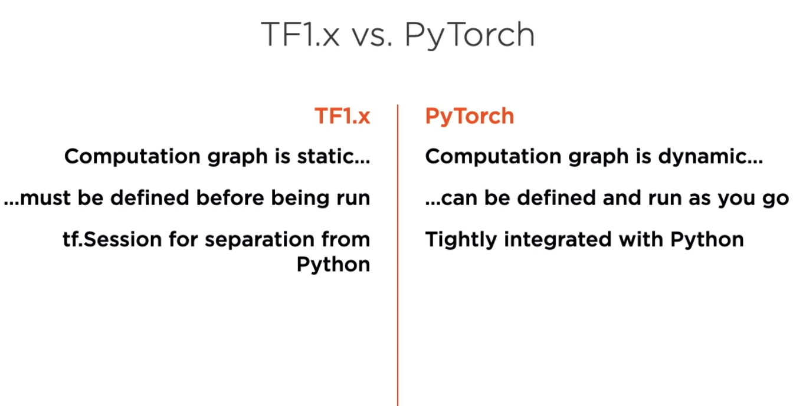
A. TensorFlow 1.x vs TensorFlow 2.0

Slide 9
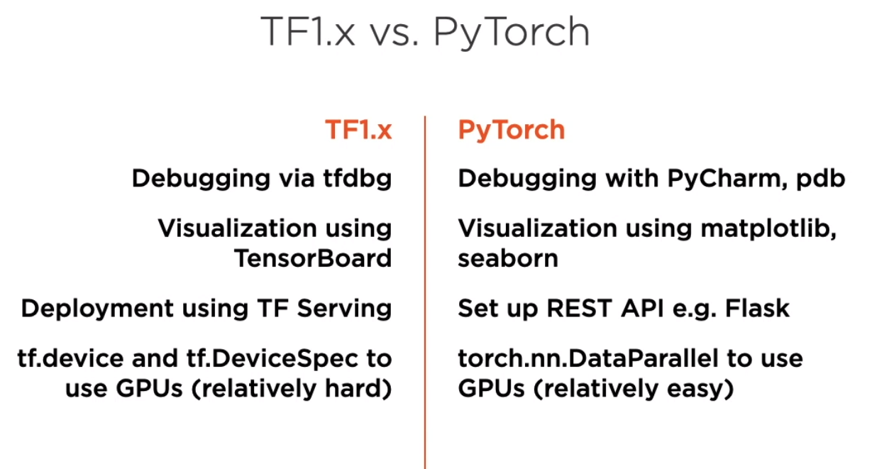
A. TensorFlow 1.x vs TensorFlow 2.0

Slide 10
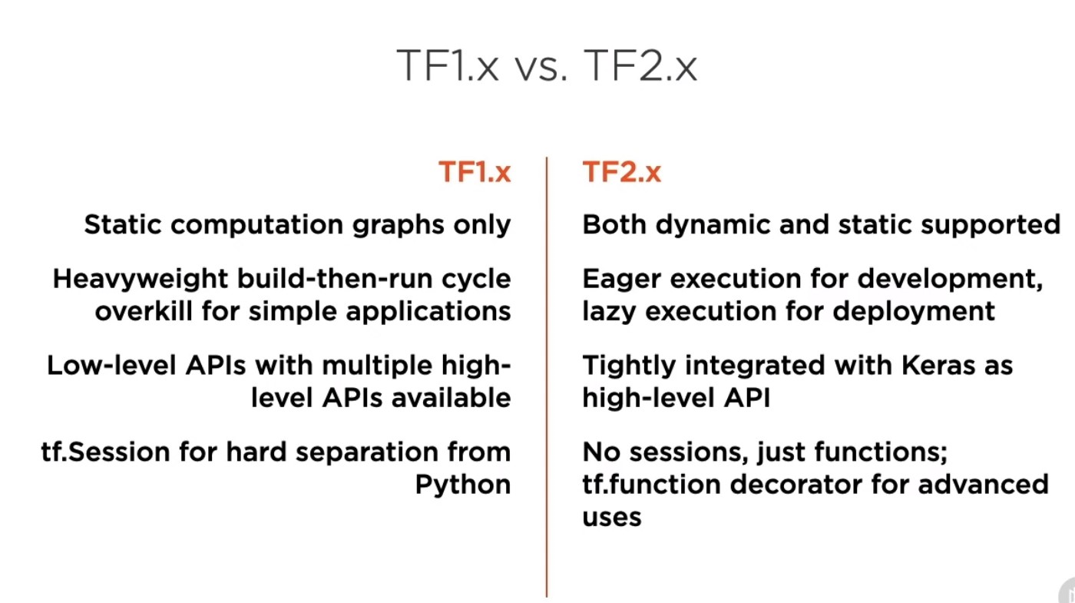

Slide 11
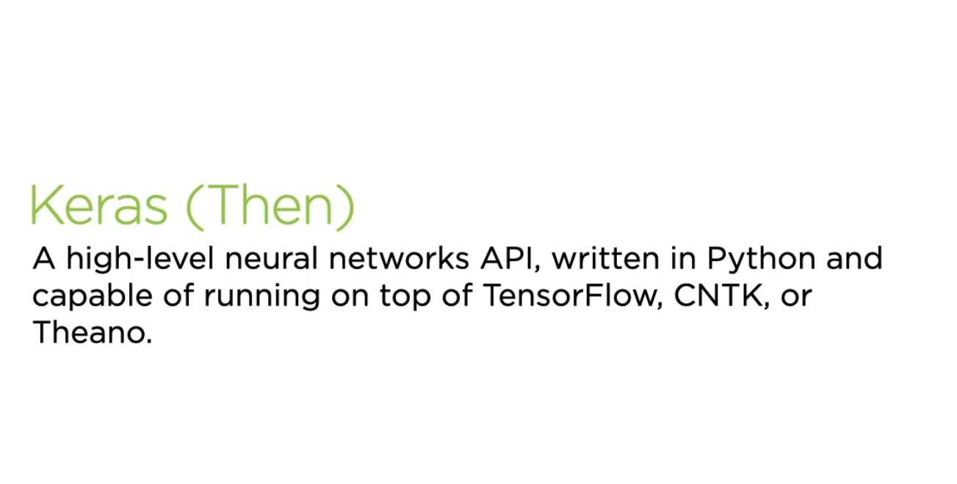
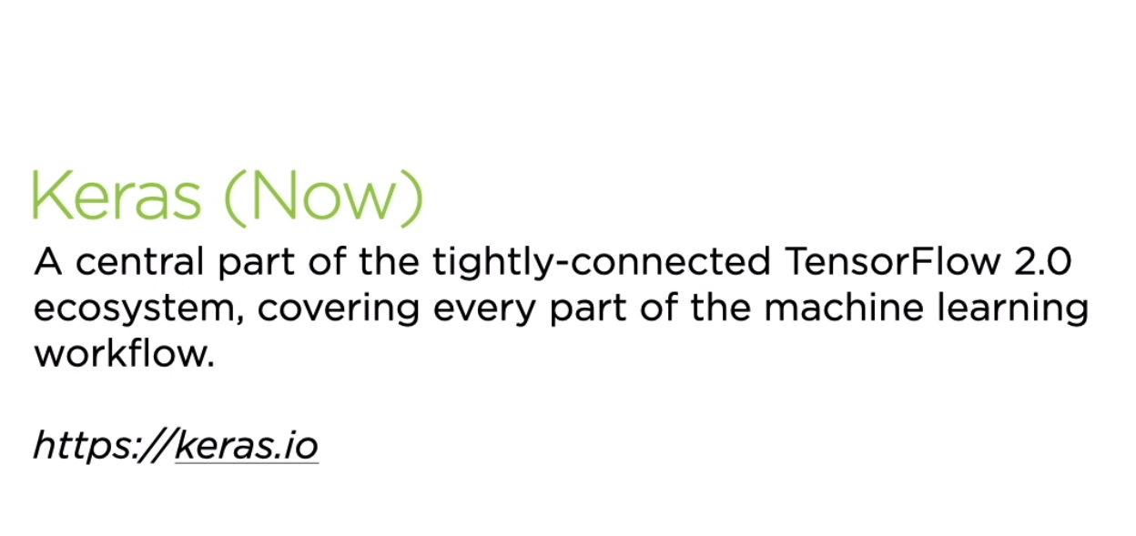

Slide 12
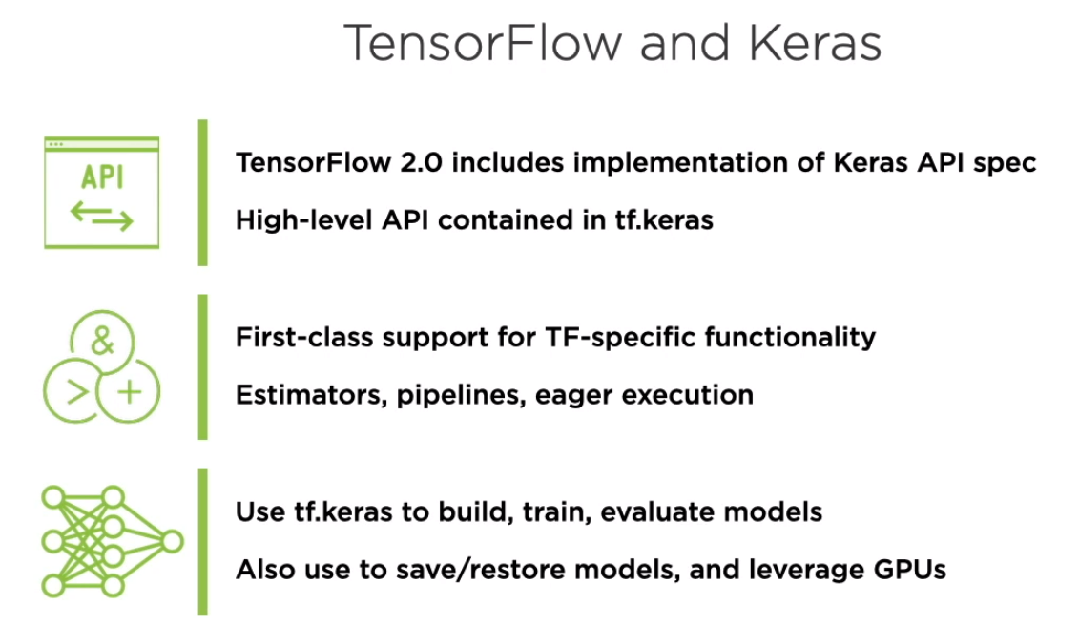

Slide 13
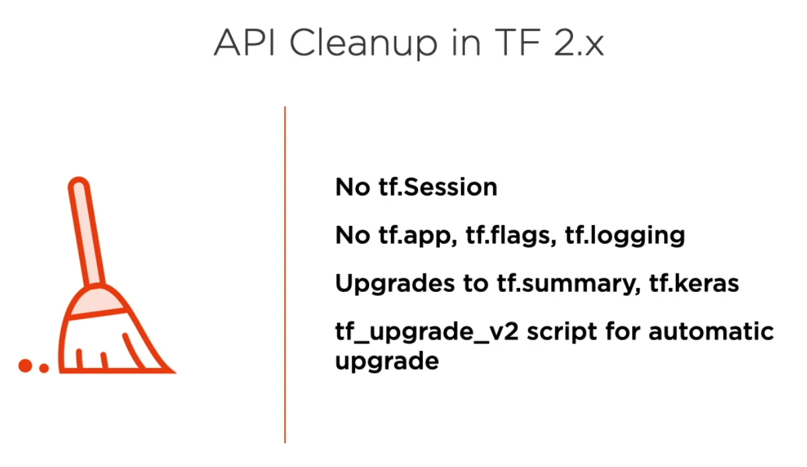
A. TensorFlow 1.x vs TensorFlow 2.0

Slide 14
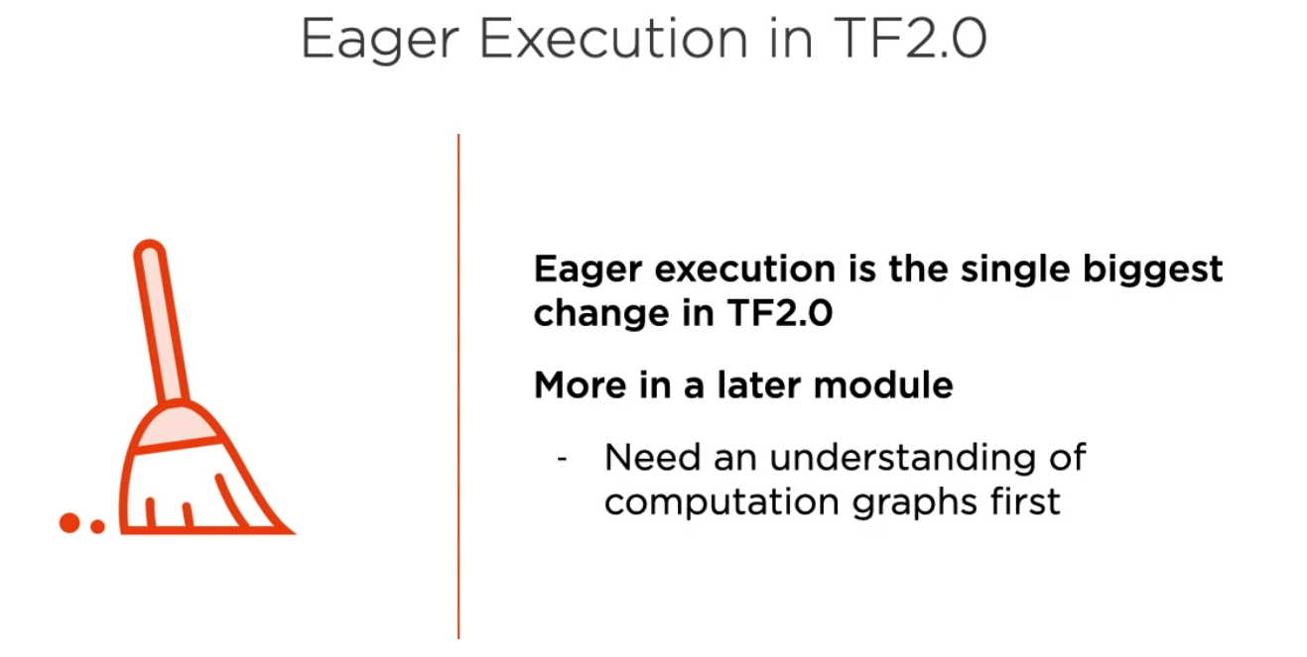
A. TensorFlow 1.x vs TensorFlow 2.0

Slide 15

B. Introducing Neural Networks

Slide 16
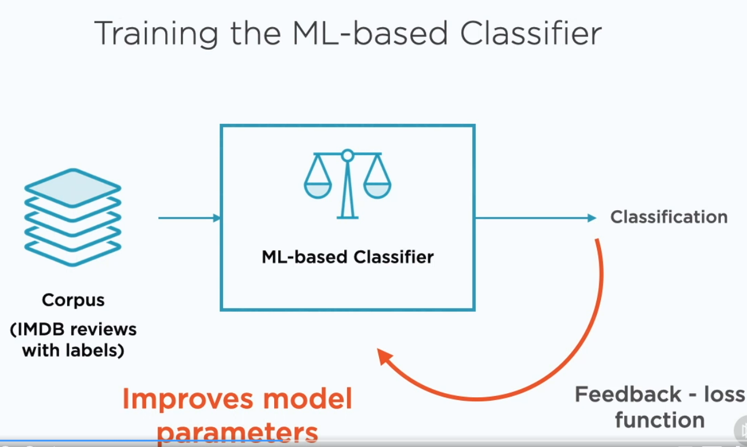
B. Introducing Neural Networks

Slide 17
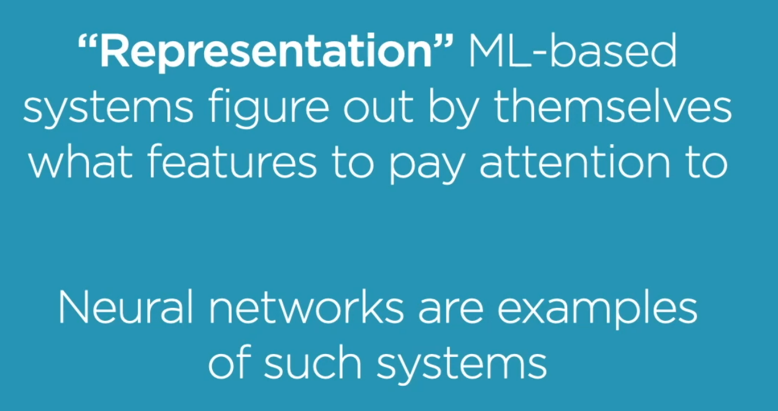
B. Introducing Neural Networks

Slide 18
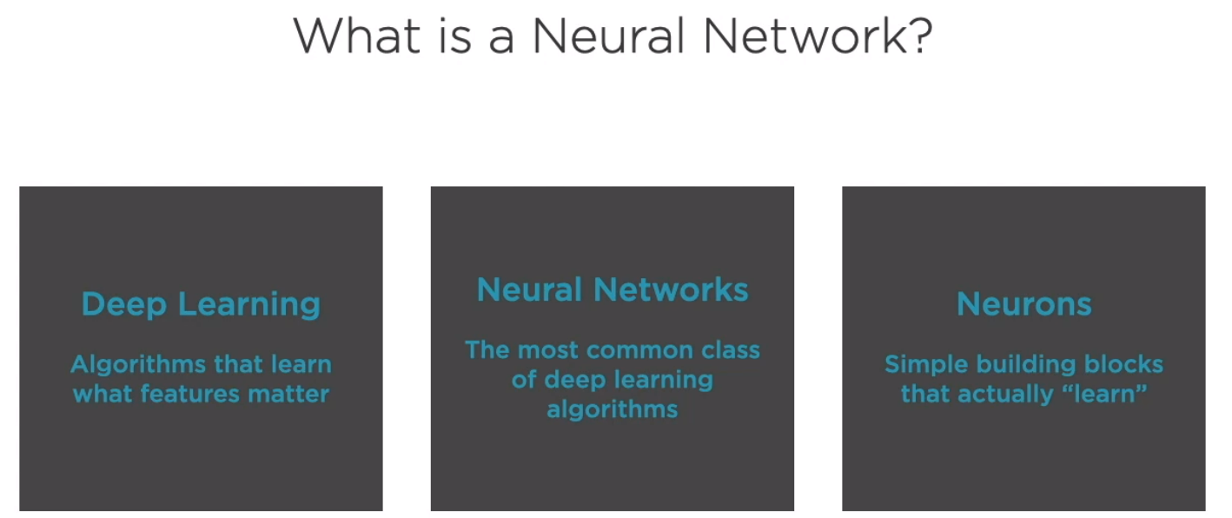
B. Introducing Neural Networks

Slide 19
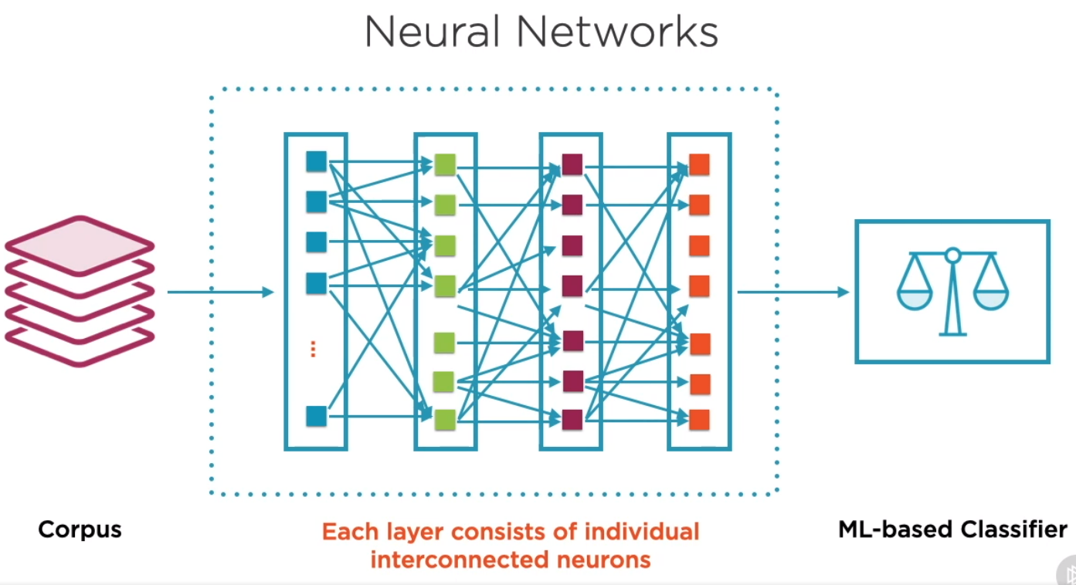
B. Introducing Neural Networks

Slide 20
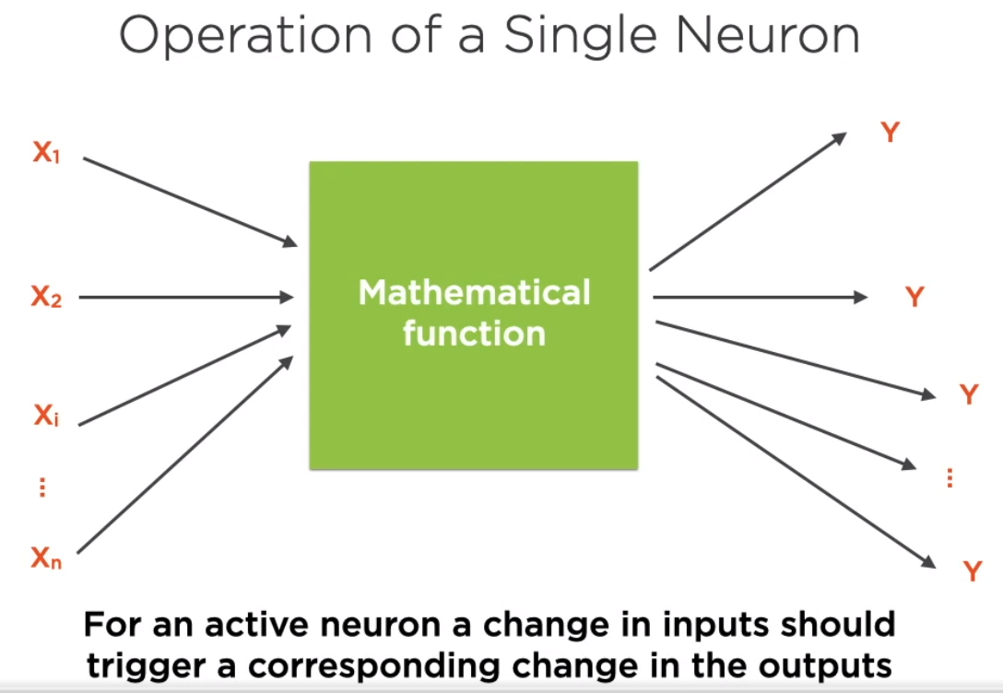
C. Neurons and Activation Functions

Slide 21
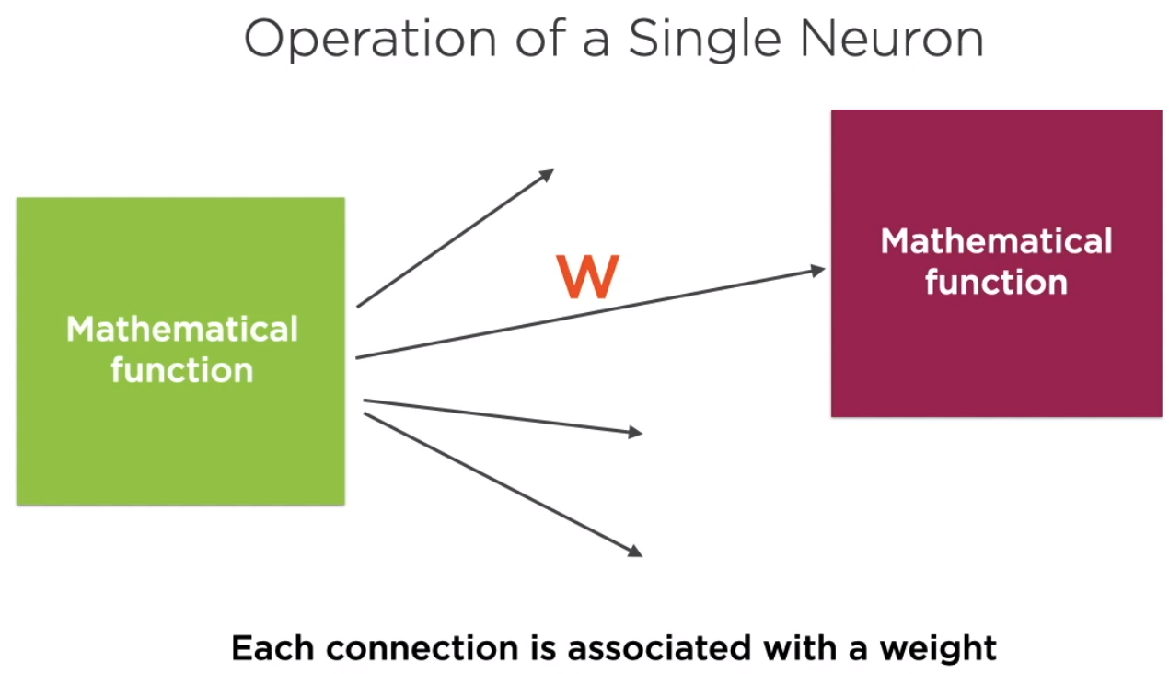
C. Neurons and Activation Functions

Slide 22
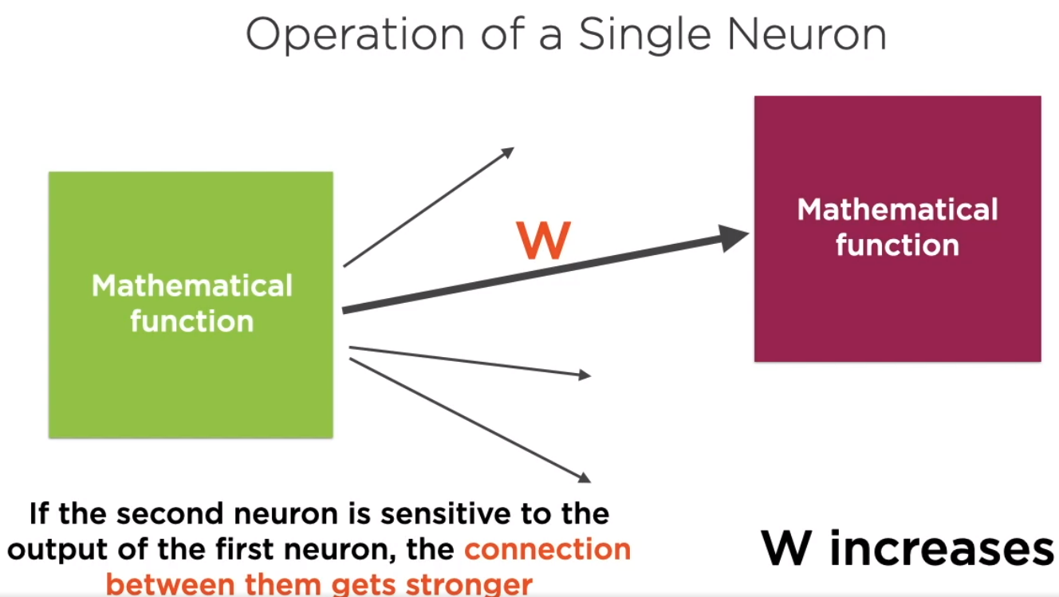
C. Neurons and Activation Functions

Slide 23
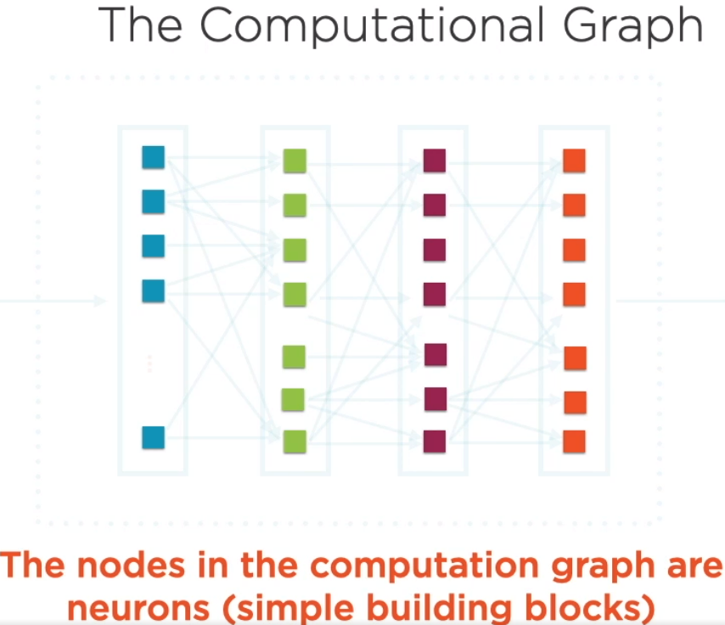
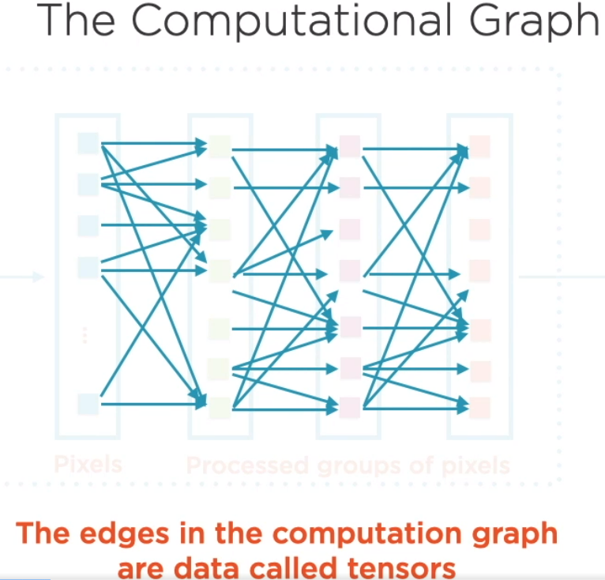
C. Neurons and Activation Functions

Slide 24
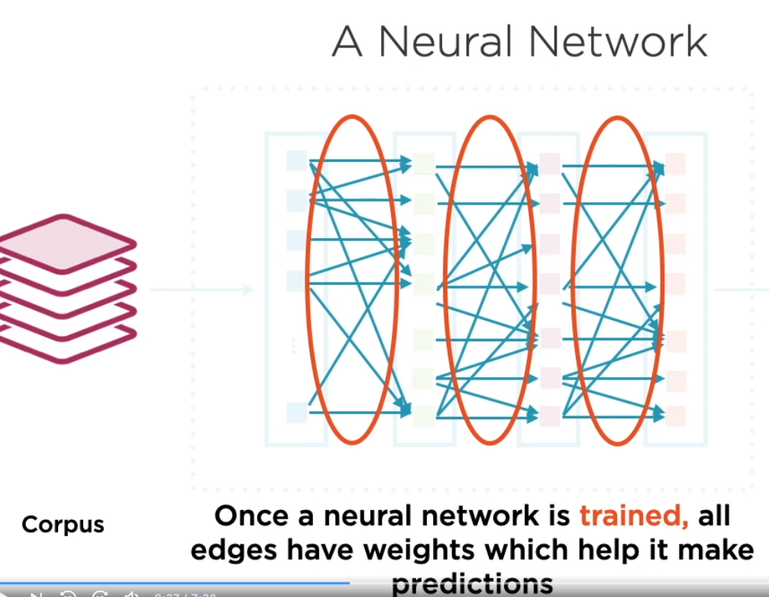
C. Neurons and Activation Functions

Slide 25
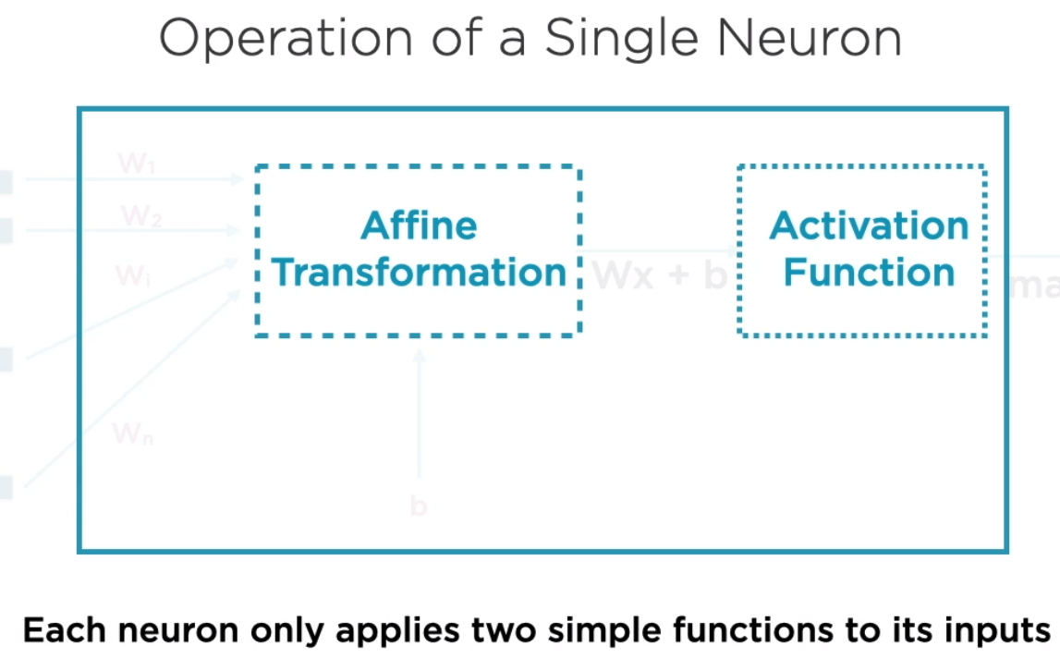
C. Neurons and Activation Functions

Slide 26
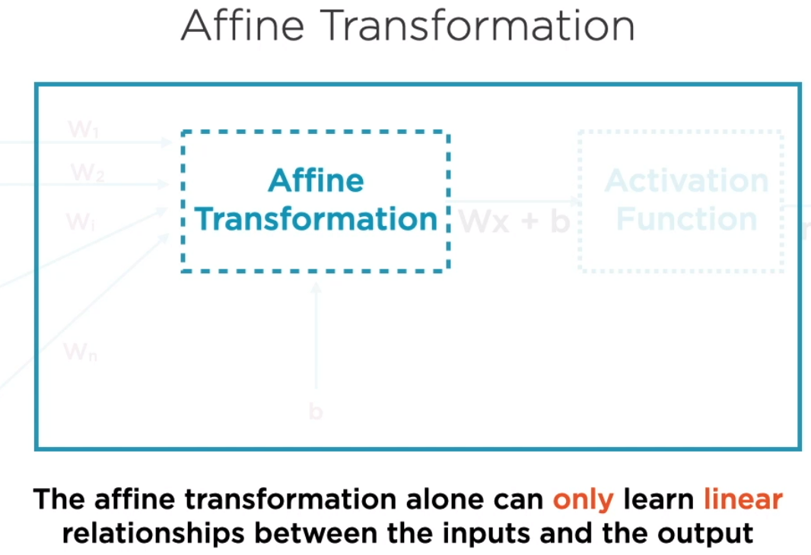
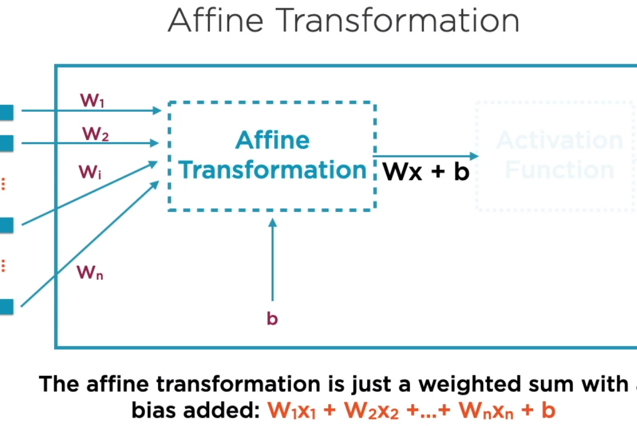
C. Neurons and Activation Functions

Slide 27
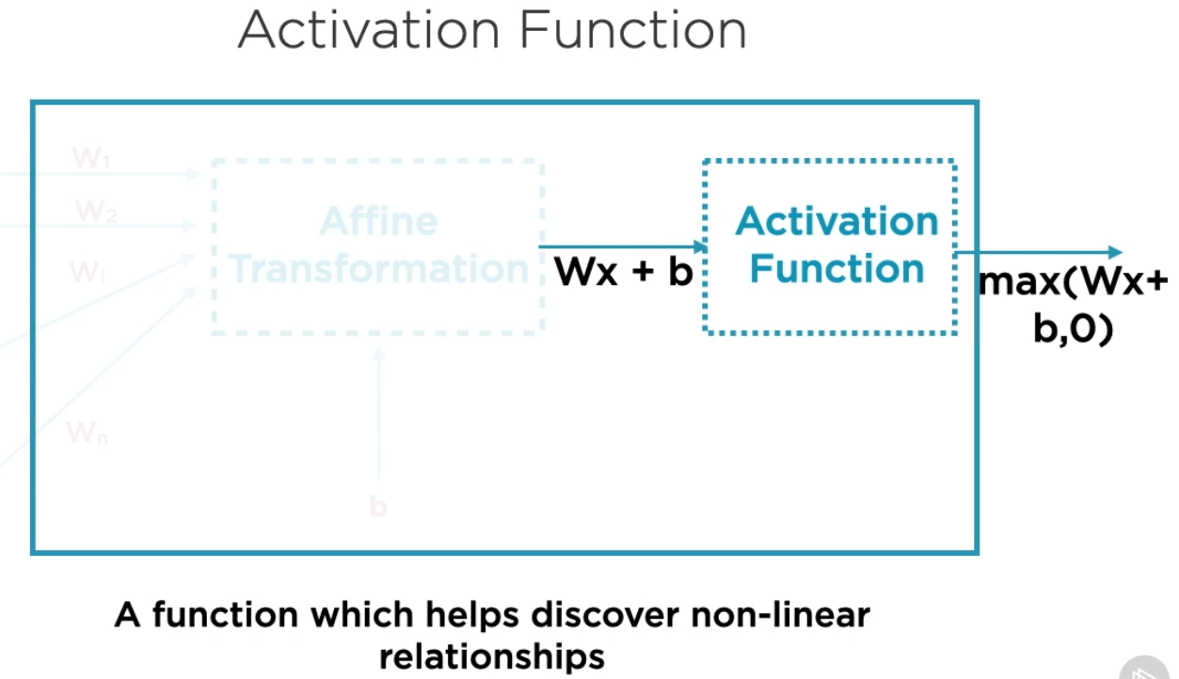
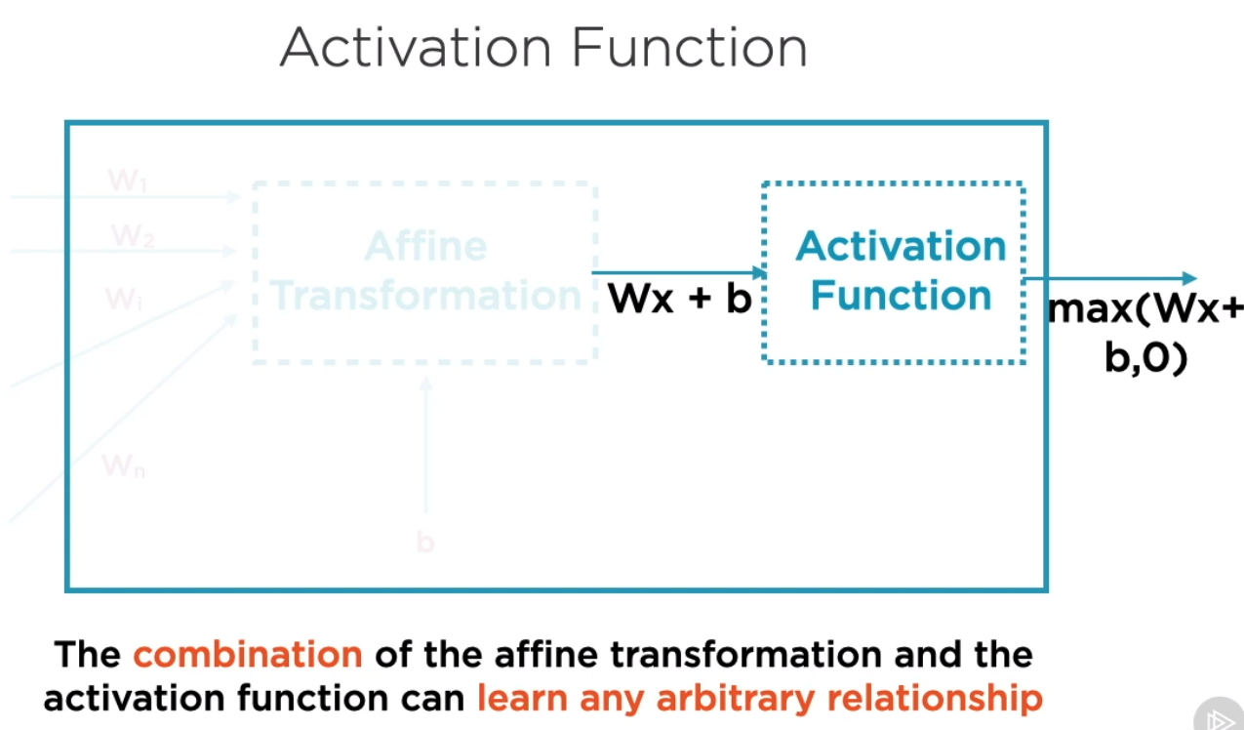
C. Neurons and Activation Functions

Slide 28
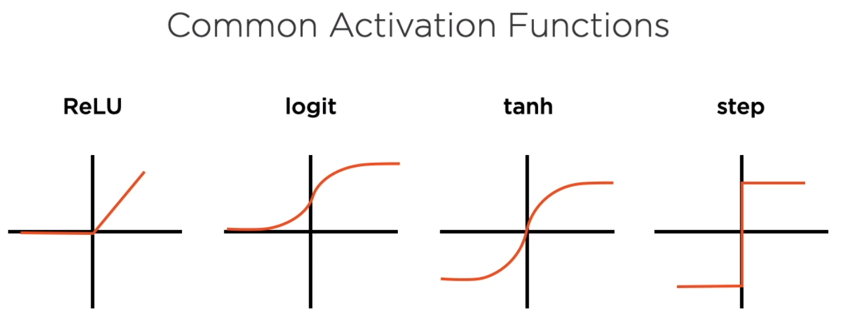
C. Neurons and Activation Functions

Slide 29
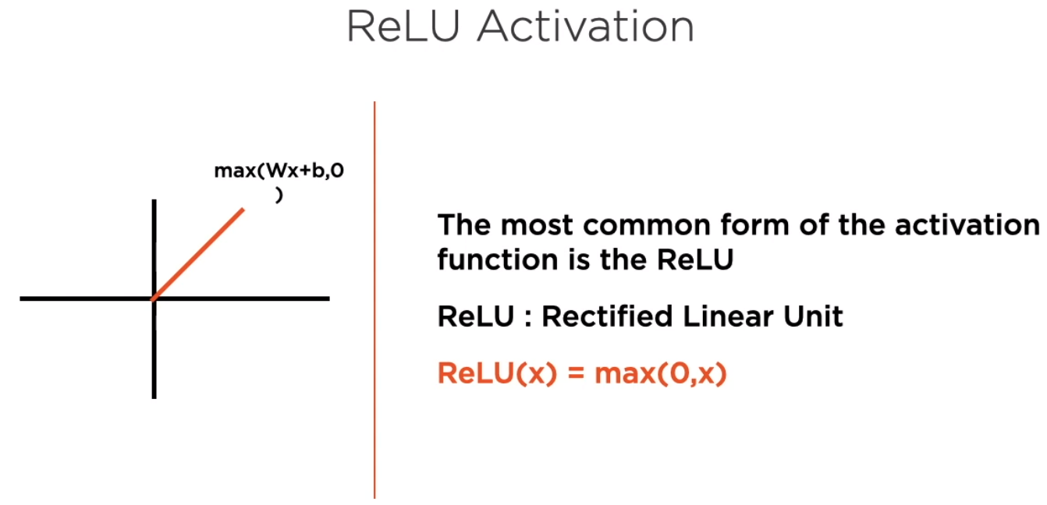
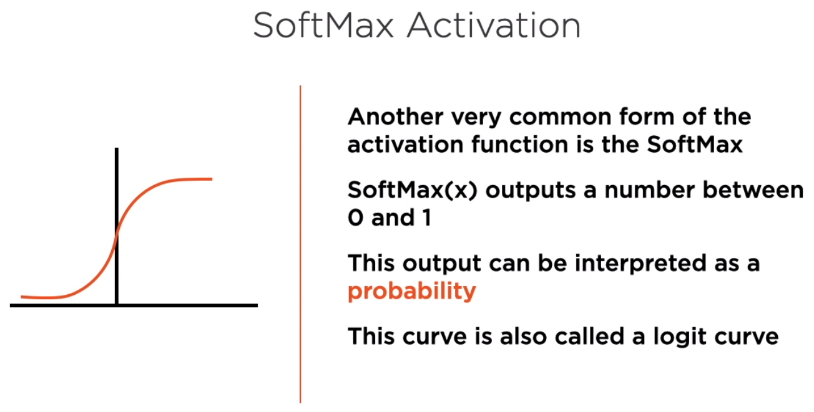
C. Neurons and Activation Functions

Slide 30
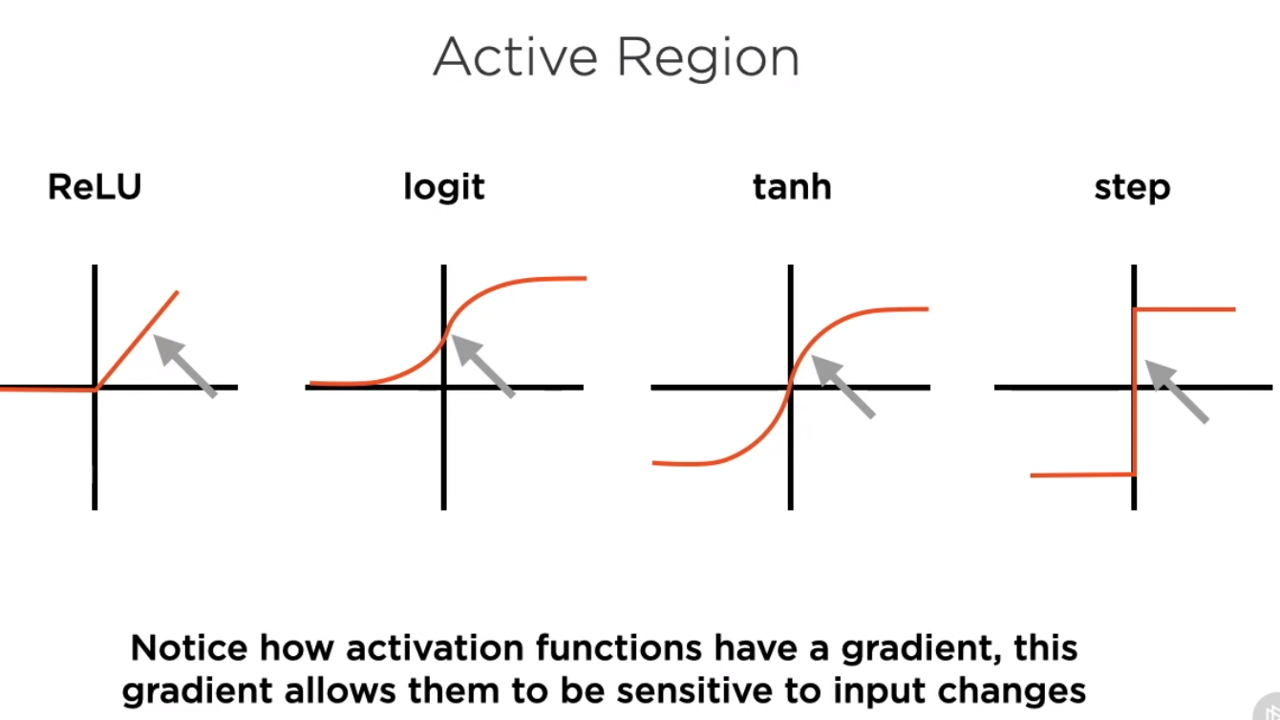
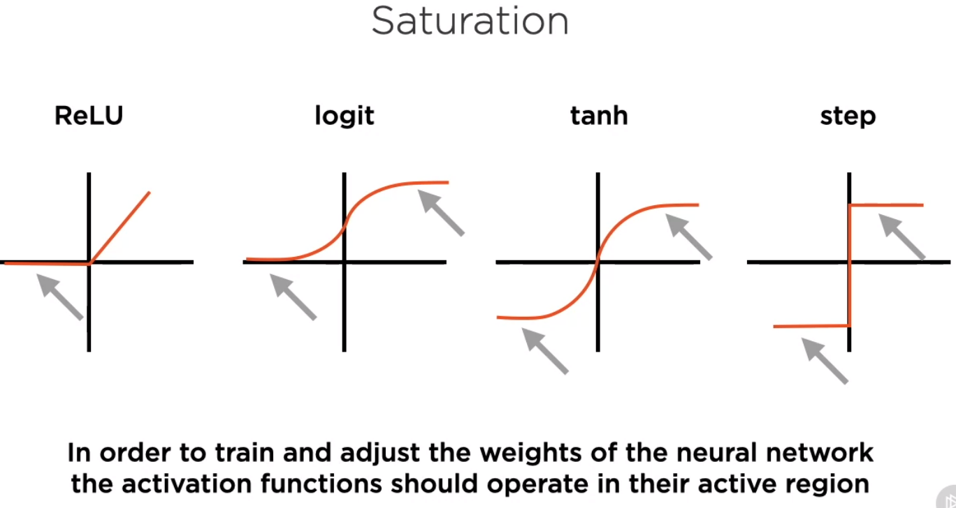
C. Neurons and Activation Functions

Slide 31
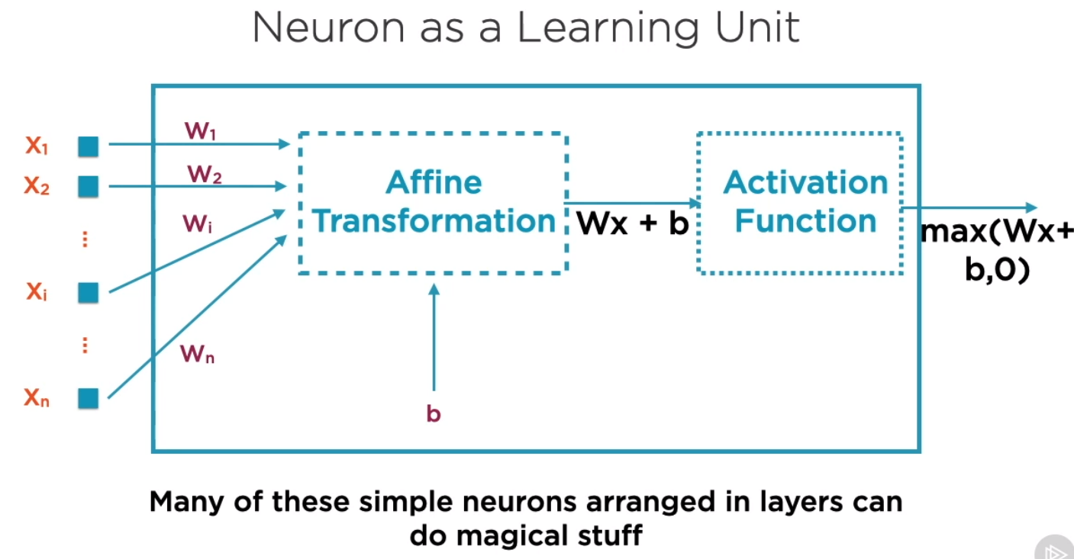
C. Neurons and Activation Functions

Slide 32
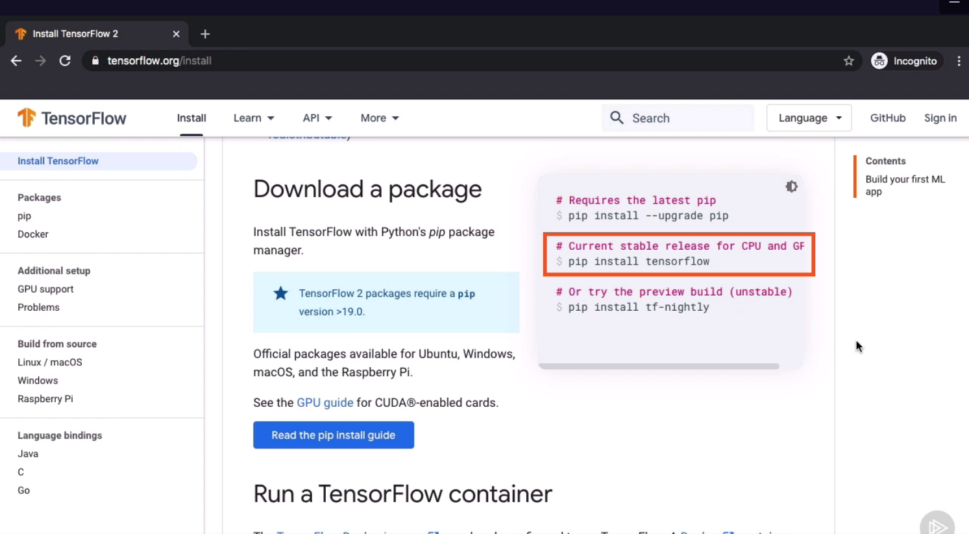
D. Working with Tensors and Variables

Slide 33
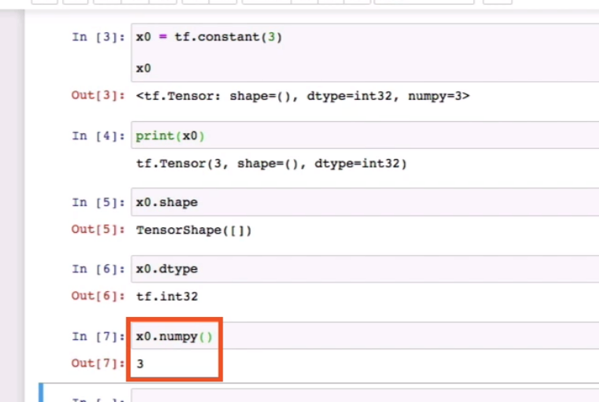
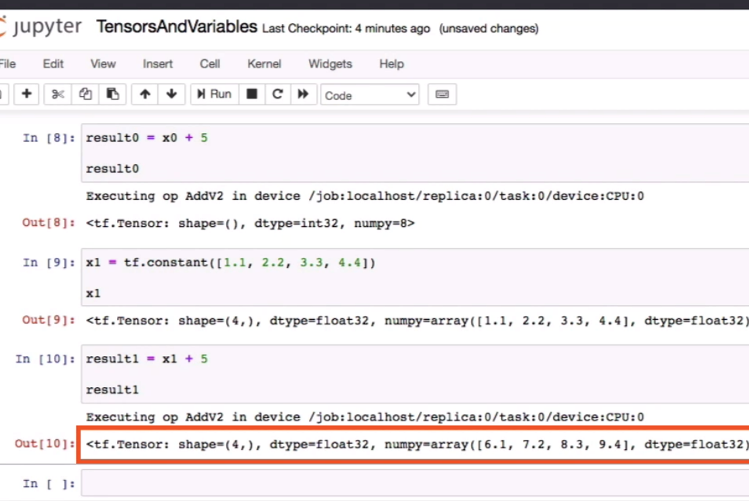
D. Demo: Working with Tensors

Slide 34
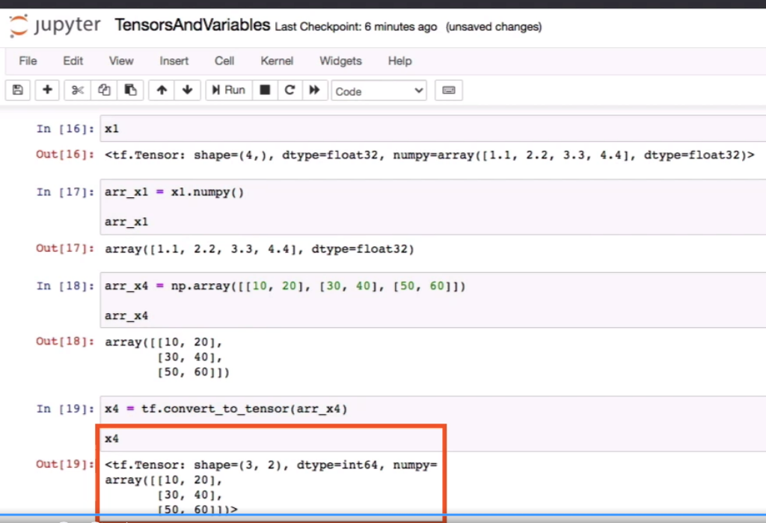
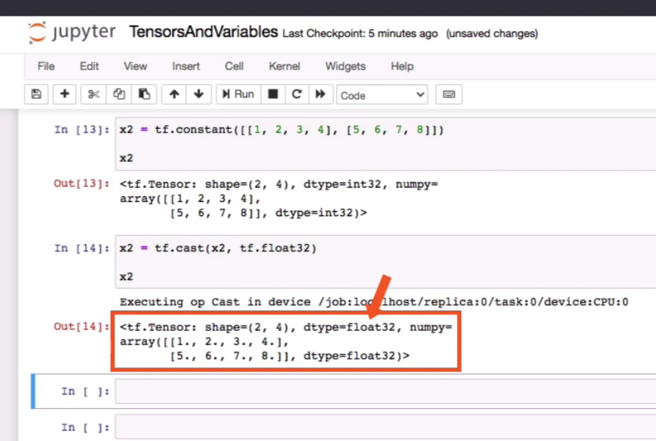
D. Demo: Working with Tensors

Slide 35
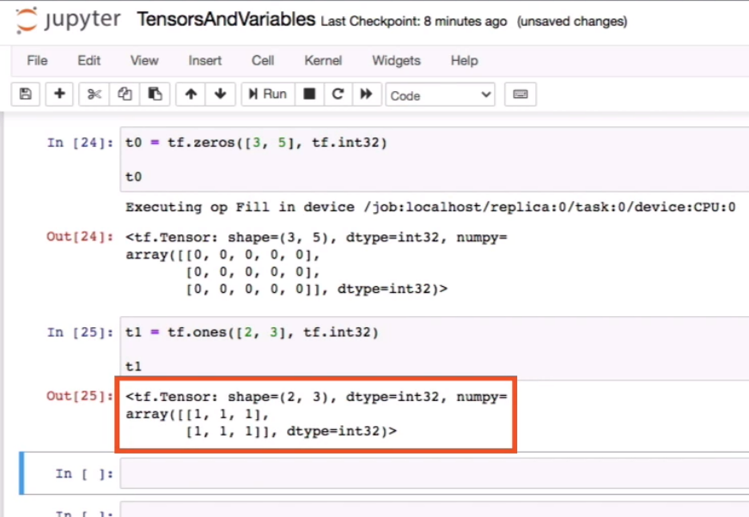
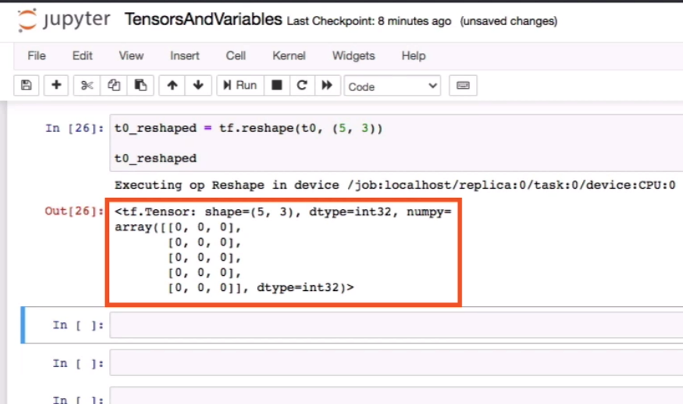
D. Demo: Working with Tensors - Operations

Slide 36
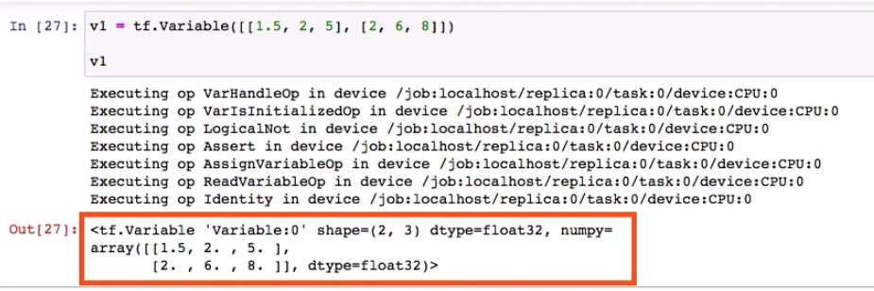
D. Demo: Working with Variables
Variables unlike tensors are mutable (most important example such as the assign operation can’t be performed on tensors). They are recommended way to share the persistent states in the program.
It is a mutable container holding tensors. If you don’t specify any data type TensorFlow will by default specify it to some data type.
TensorFlow operations can be applied to the variables as well. The variable can be converted to the tensors or NumPy as well.

Slide 37
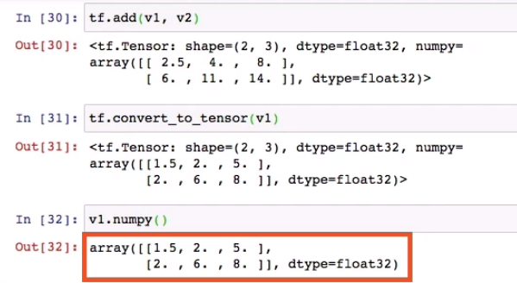
D. Working with Variables

Slide 38
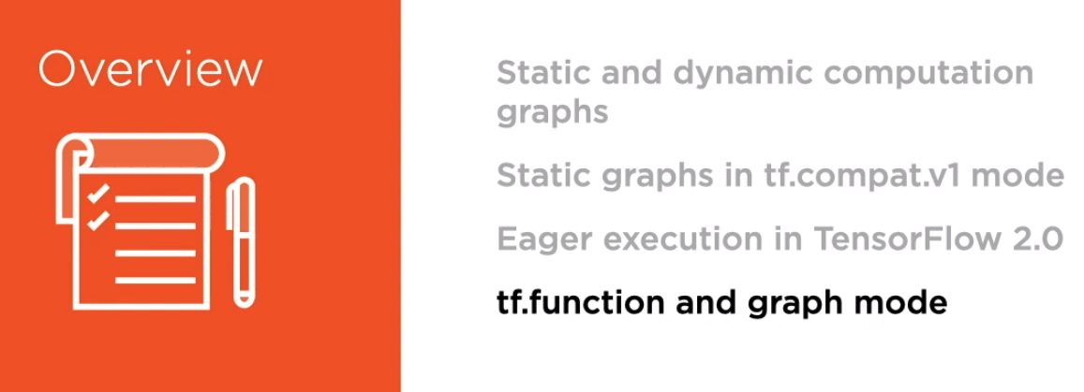
Module 2: Understanding Dynamic and Static Computation Graphs

Slide 39
Contents in Brief in Module 2
A. The Computation Graph
B. Static and Dynamic Computation Graphs
C. Demo – TensorFlow V1 Sessions to Execute Static Computation graphs
D. Tensor board to Visualize Graphs

Slide 40
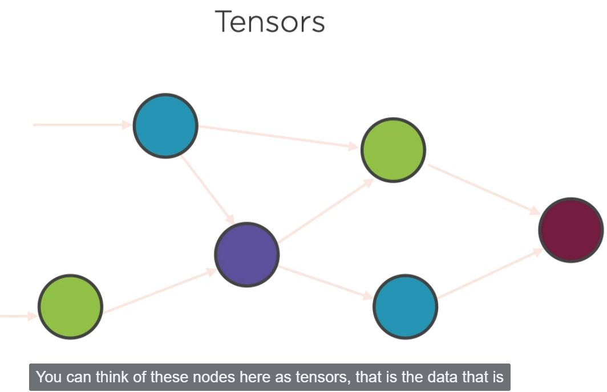
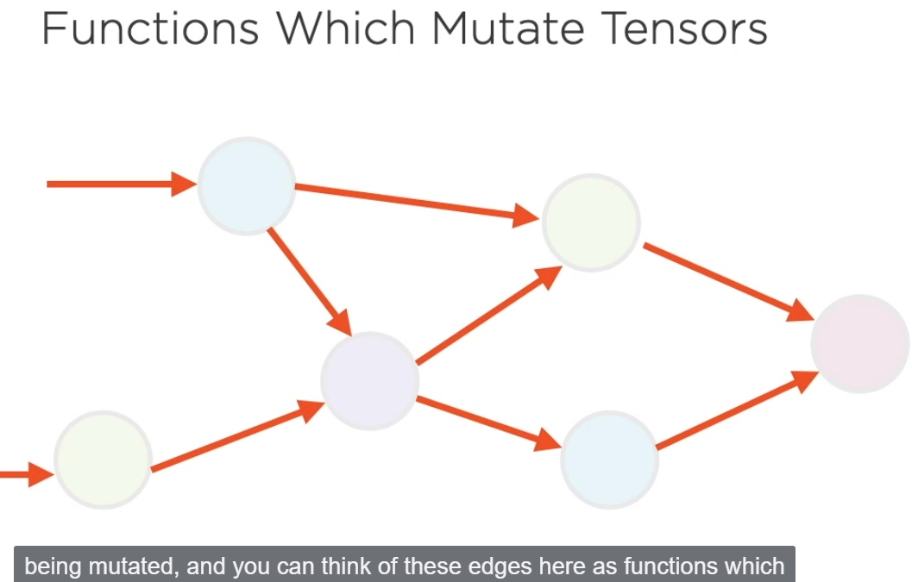
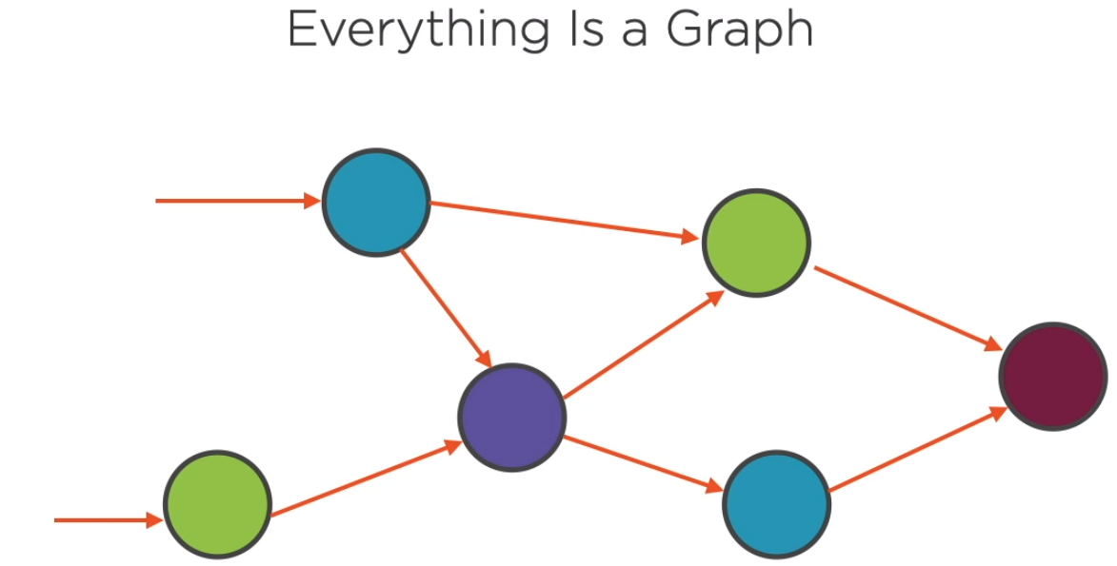
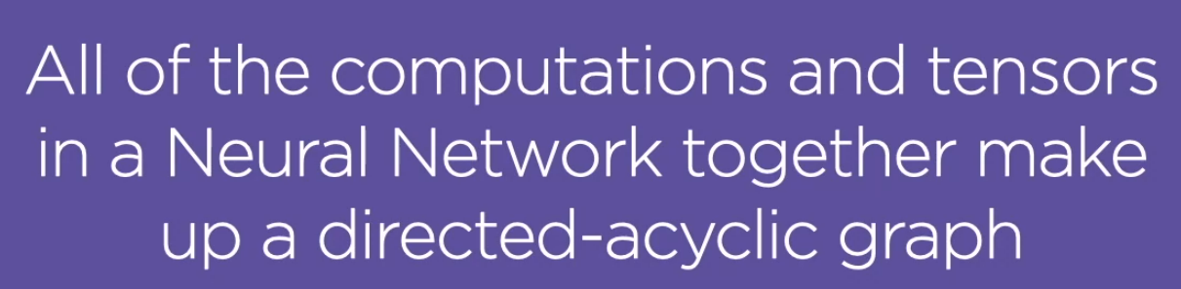
A. The Computation Graph
The series of computations and the transformations that these computations apply make up a computation graph.
Nodes can be thought as the neurons and the edges in the graphs can be thought as the functions.
Executing the graph transforms the input tensors to the output results.

Slide 41
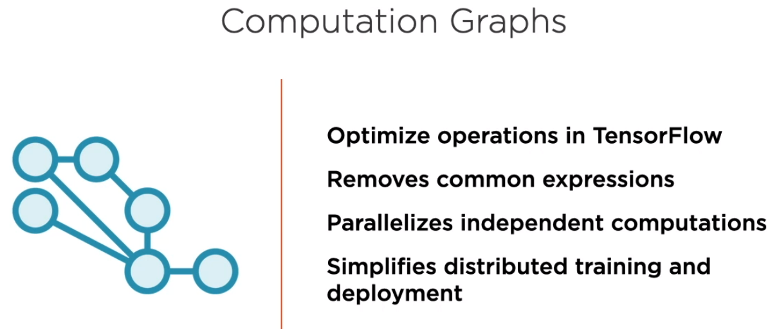
A. The Computation Graph
Representing all the computations in the form of a graph is very powerful because the graph allows the Tensor Flow framework to optimize the operations that you perform on the input data.

Slide 42
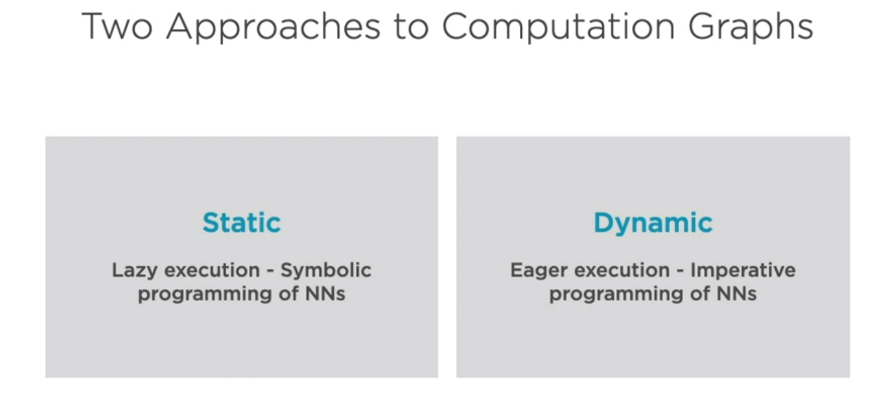
B. Static and Dynamic Computation Graphs

Slide 43


Slide 44


Slide 46


Slide 47



Slide 48


Slide 49

Static graphs are easy to optimize and hence TF1.0 still supports static graphs as well.

Slide 50

Crux☺

Slide 51

C. Demo – TensorFlow V1 Sessions to Execute Static Computation graphs

